Slide 1

Protecting Artifacts
By Archeologists anonymous: Pijus, Oscar and Ruben

Slide 2
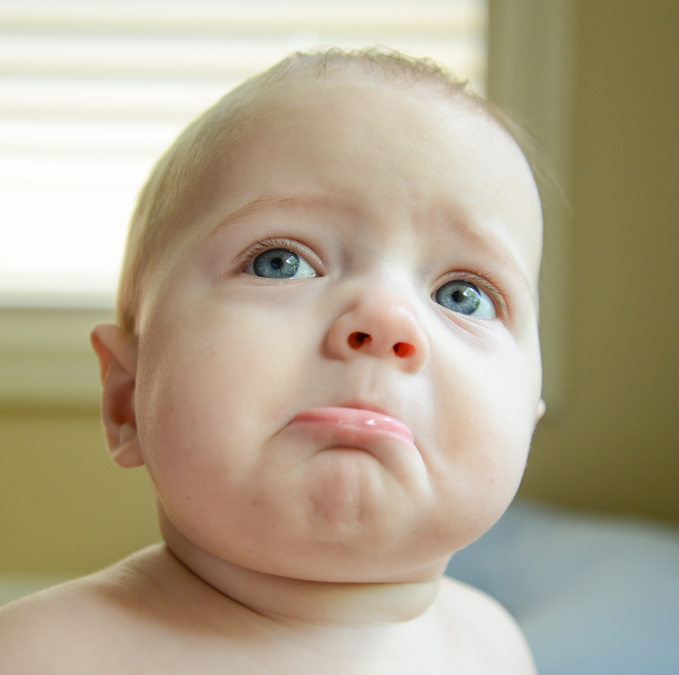
Problems Archeologists face
Artifact exposure
Damage upon excavation
Damage during transport
Looting

Slide 3
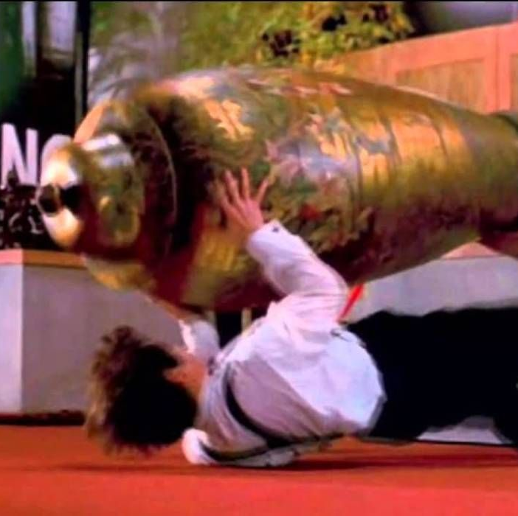
Our problem ?
Damage during transport is detrimental to the preservation of historical artifacts!

Slide 4
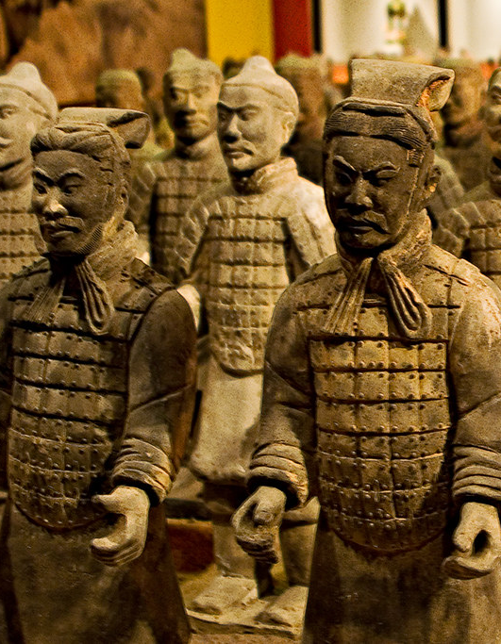
The terracotta army – case study
The teracotta army over 8000 clay soldiers that were buried for over 2000 years.
Upon initial exposure, delicate and coloured pigments flaked off causing a major archeological tradgedy
To stop the terracotta army's colours from flaking further conservationists used agents like HEMA and Electron beam curing

Slide 5
How can damage be prevented?
Non-Invasive Excavation
Control of exposure to environment
Better handling through transportation
Better security measurements

Slide 6
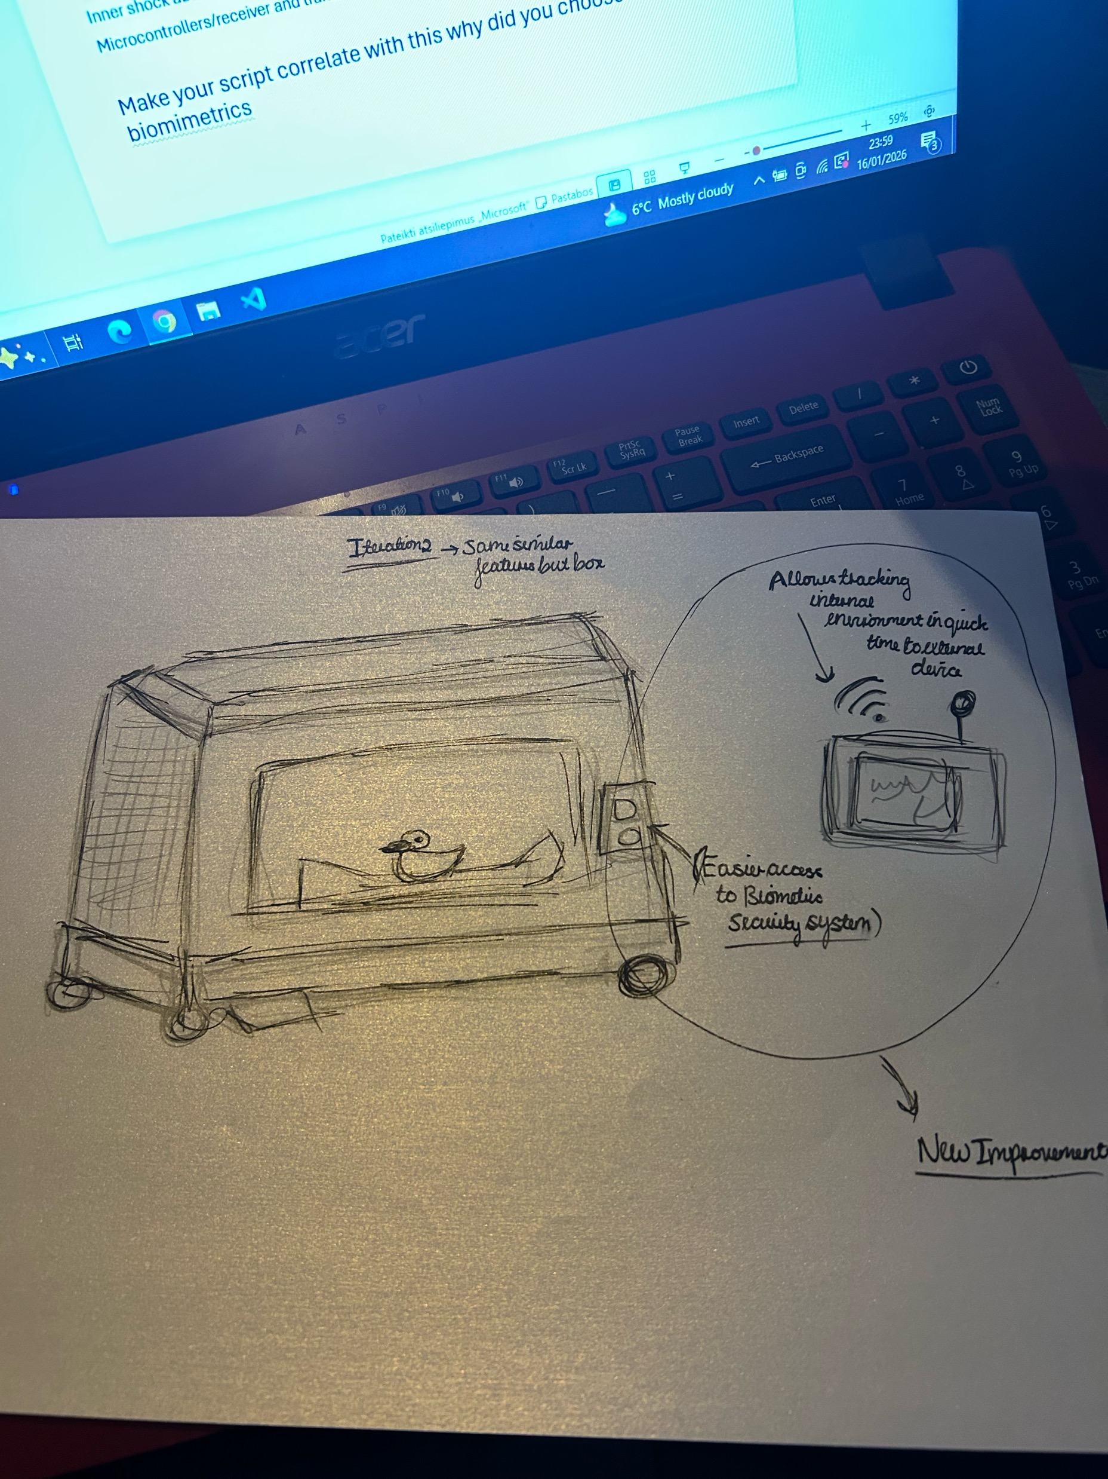
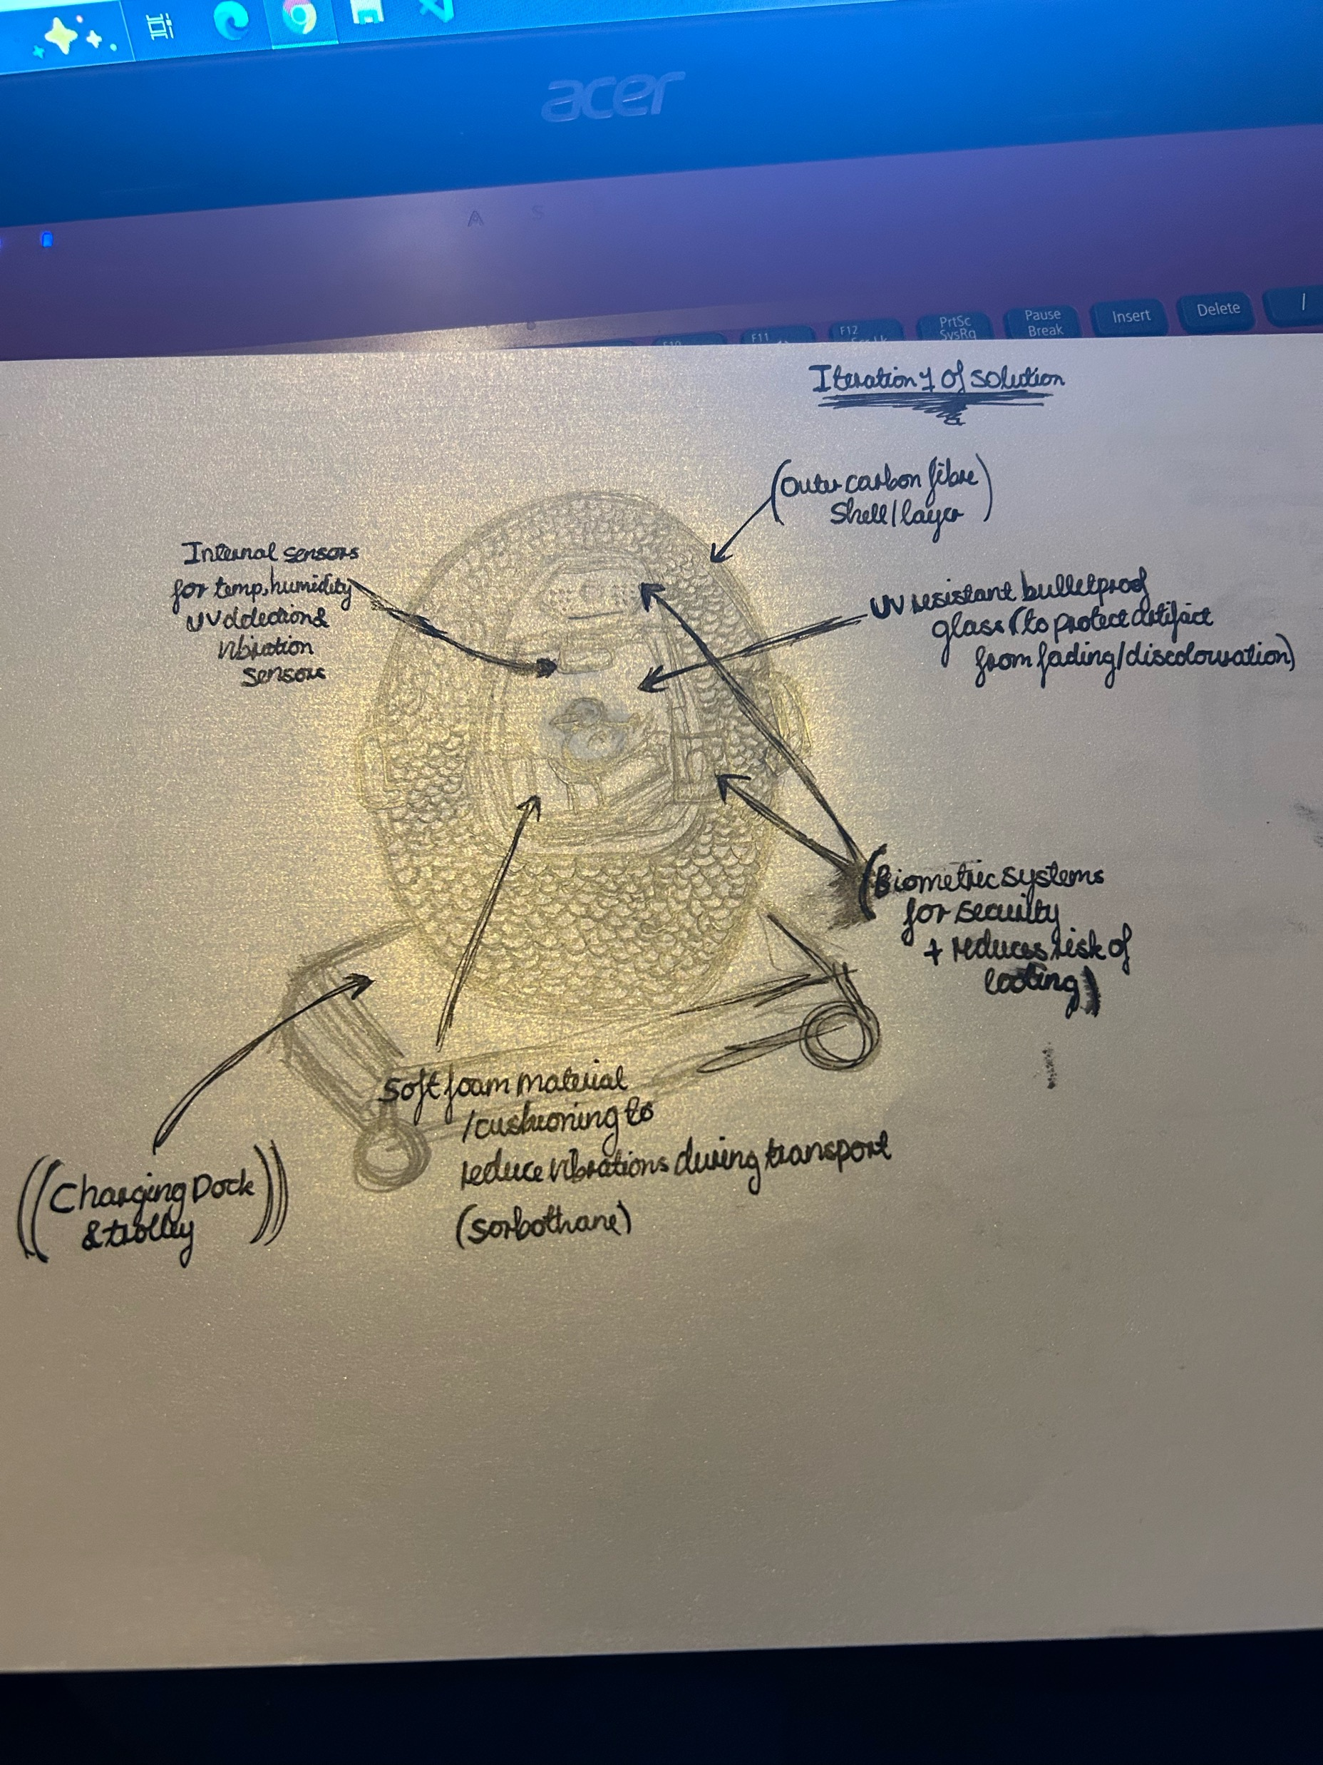
Our Solution
A smart capsule with the following features:
Carbon fiber Outer frame/shell
Biometrics system
Sensors to regulate internal conditions
Inner shock absorbent foam padding
Microcontrollers/receiver and transmitter to alert device in quick time

Slide 7
How will it benefit Archeologists?
Artifacts being damaged causes expenses for restoration and with this solution:
Time is saved
Resources are preserved for other research
Money can be better spent for more technologies

Slide 8
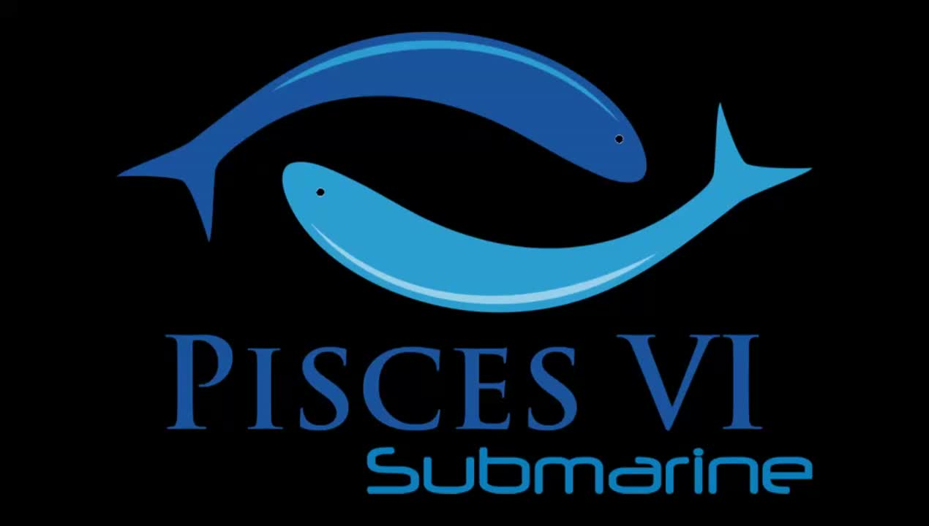
Contacted companies
Pisces VI Submarine(Same company from prior year)
Services consist of submarine underwater tours as well as underwater archaeology and recovery expeditions
This year they helped us contact an archaeologist who suggested us some ideas to further explore and provided feedback on our previous ideas also

Slide 9

Thank you for listening! Any questions?

